Slide 1
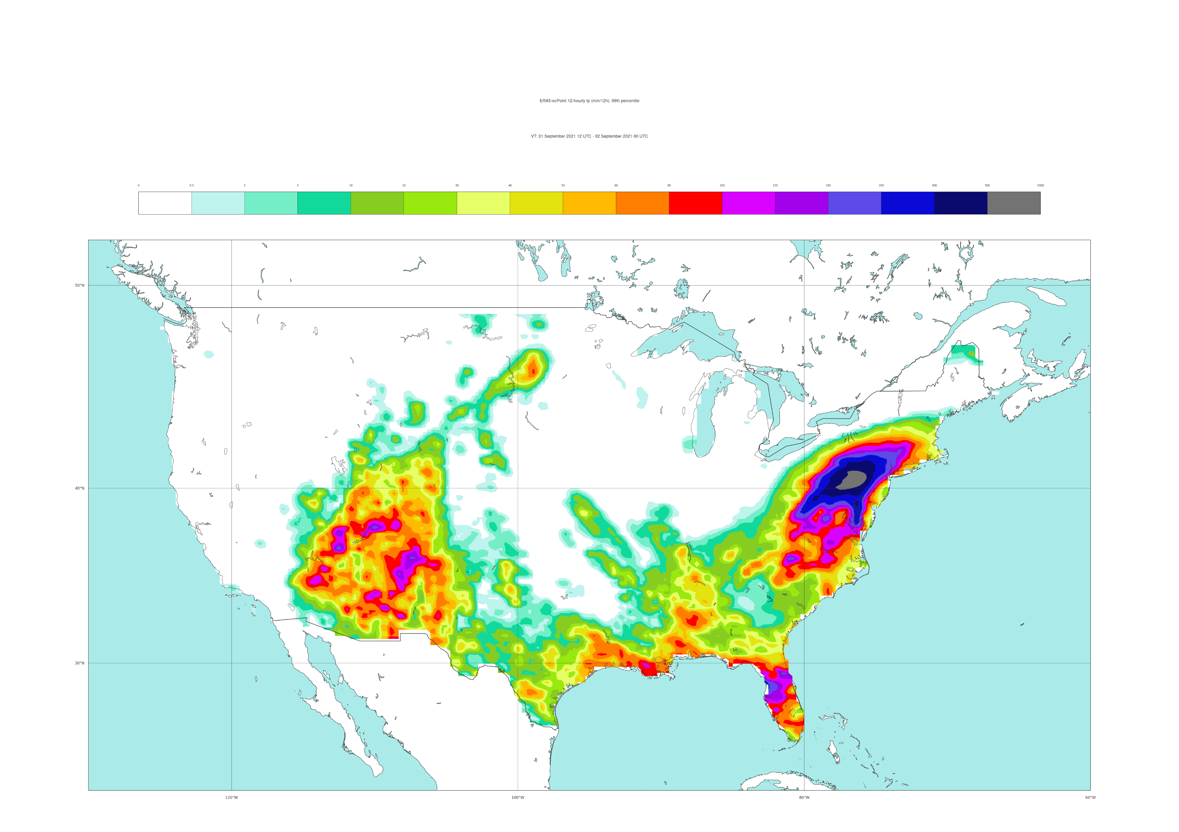
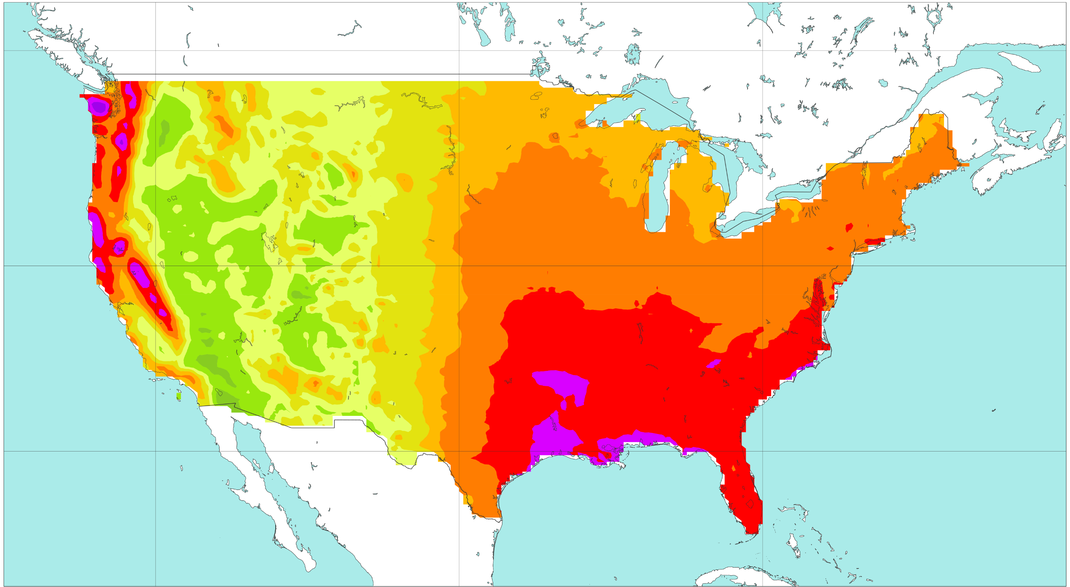
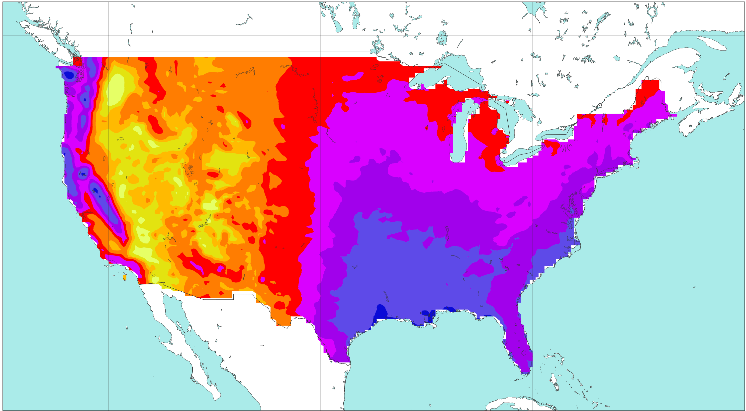
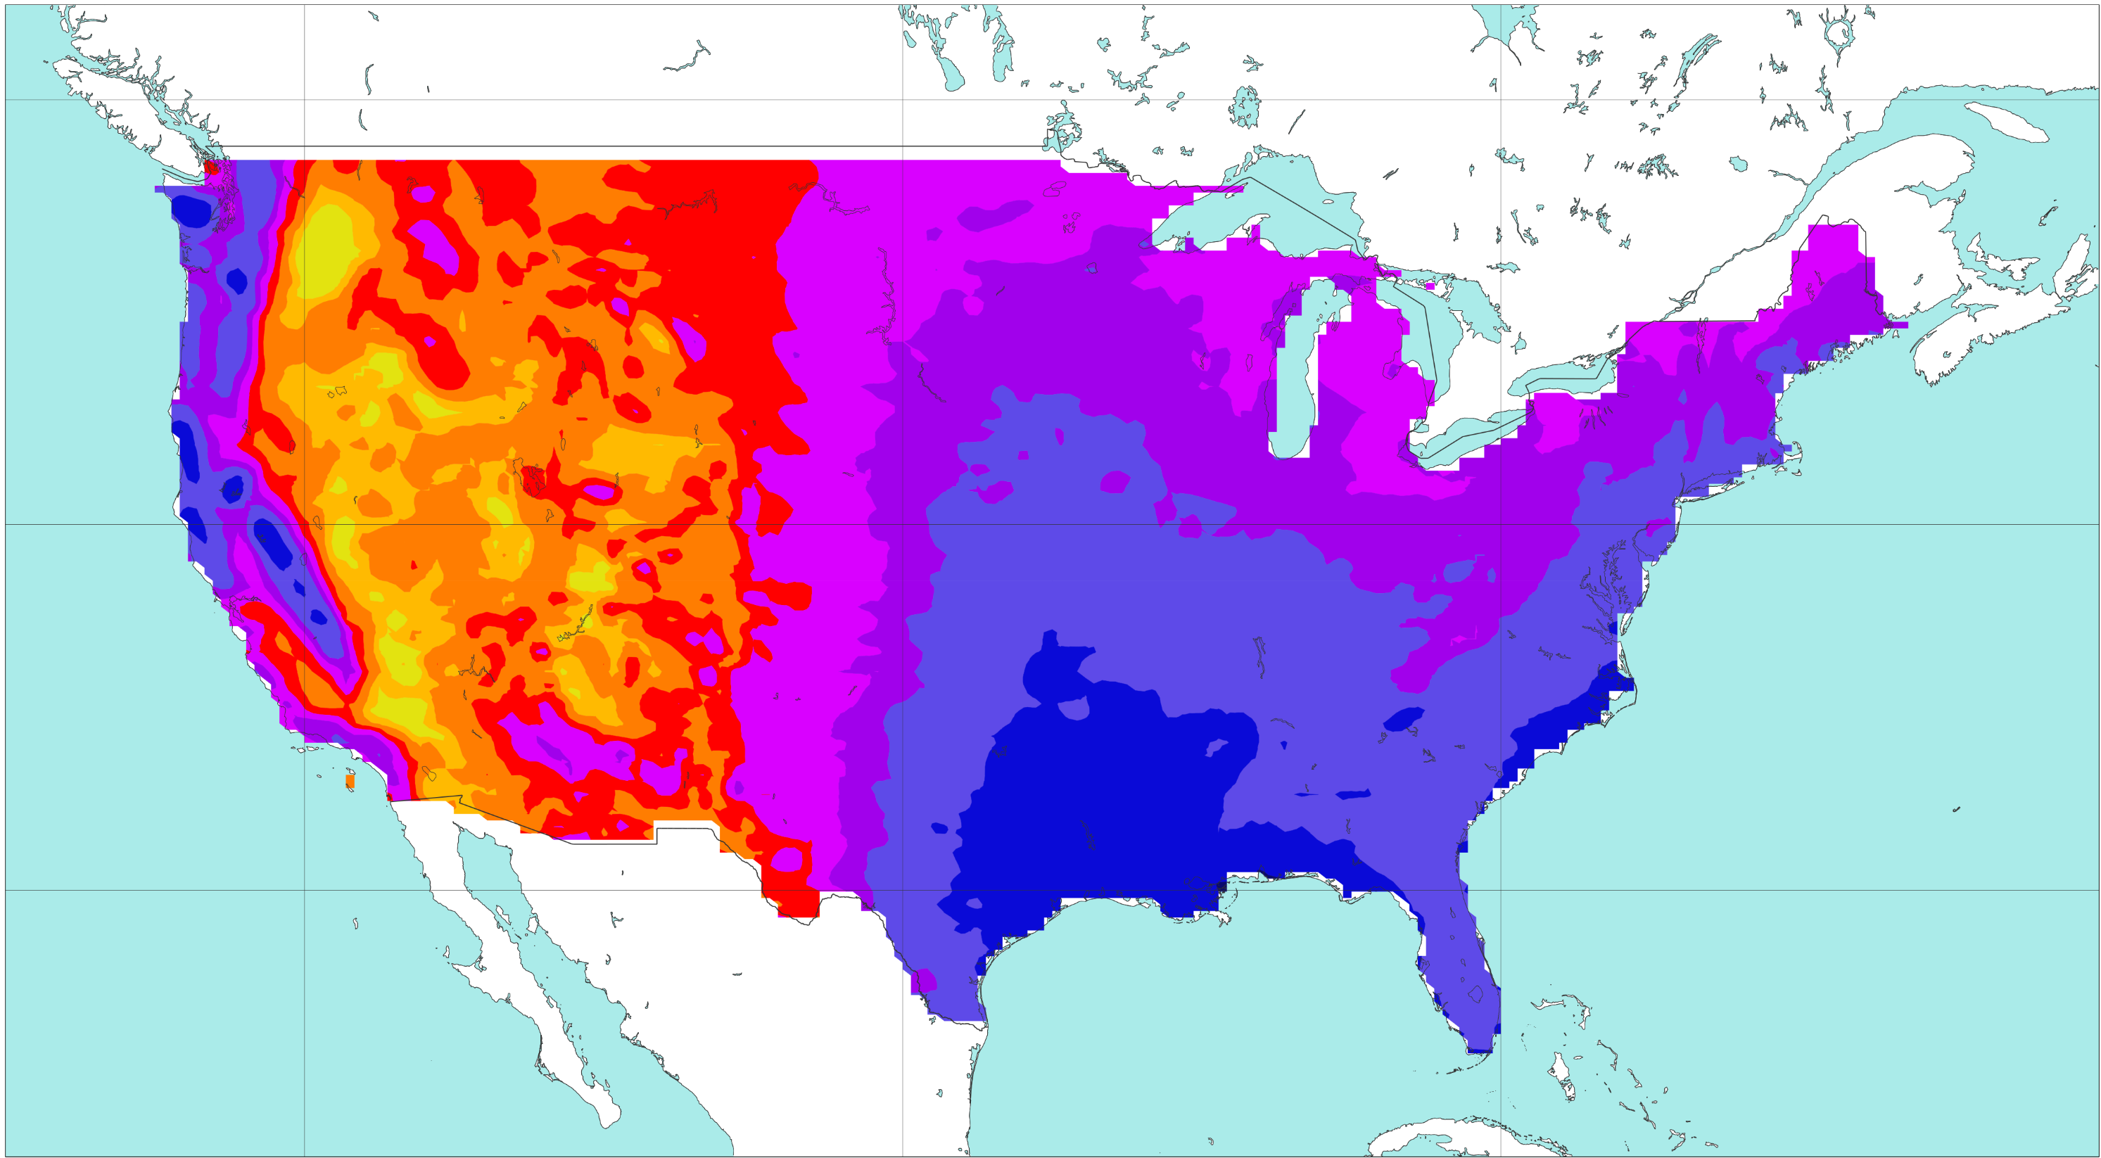
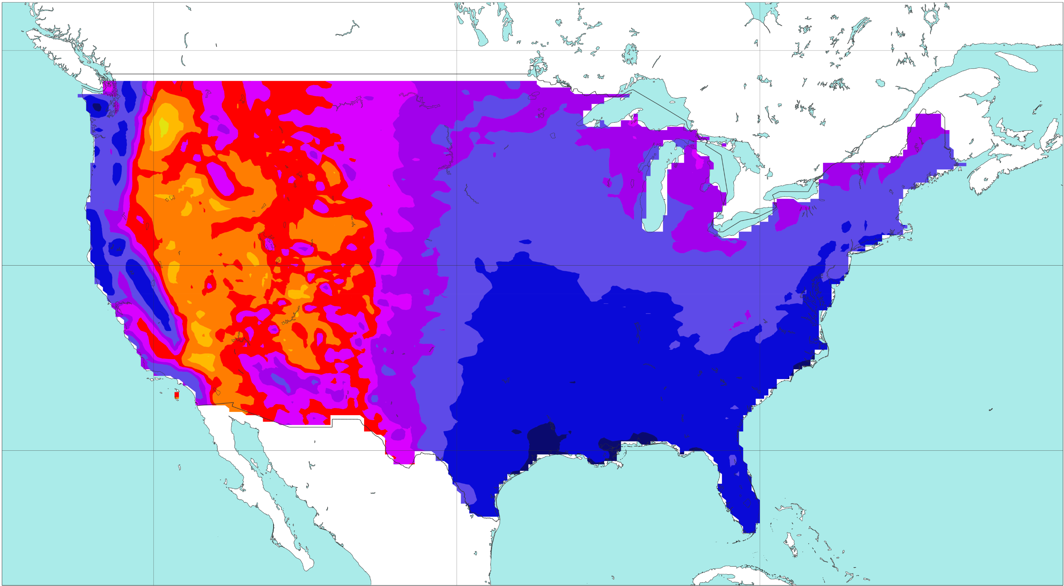
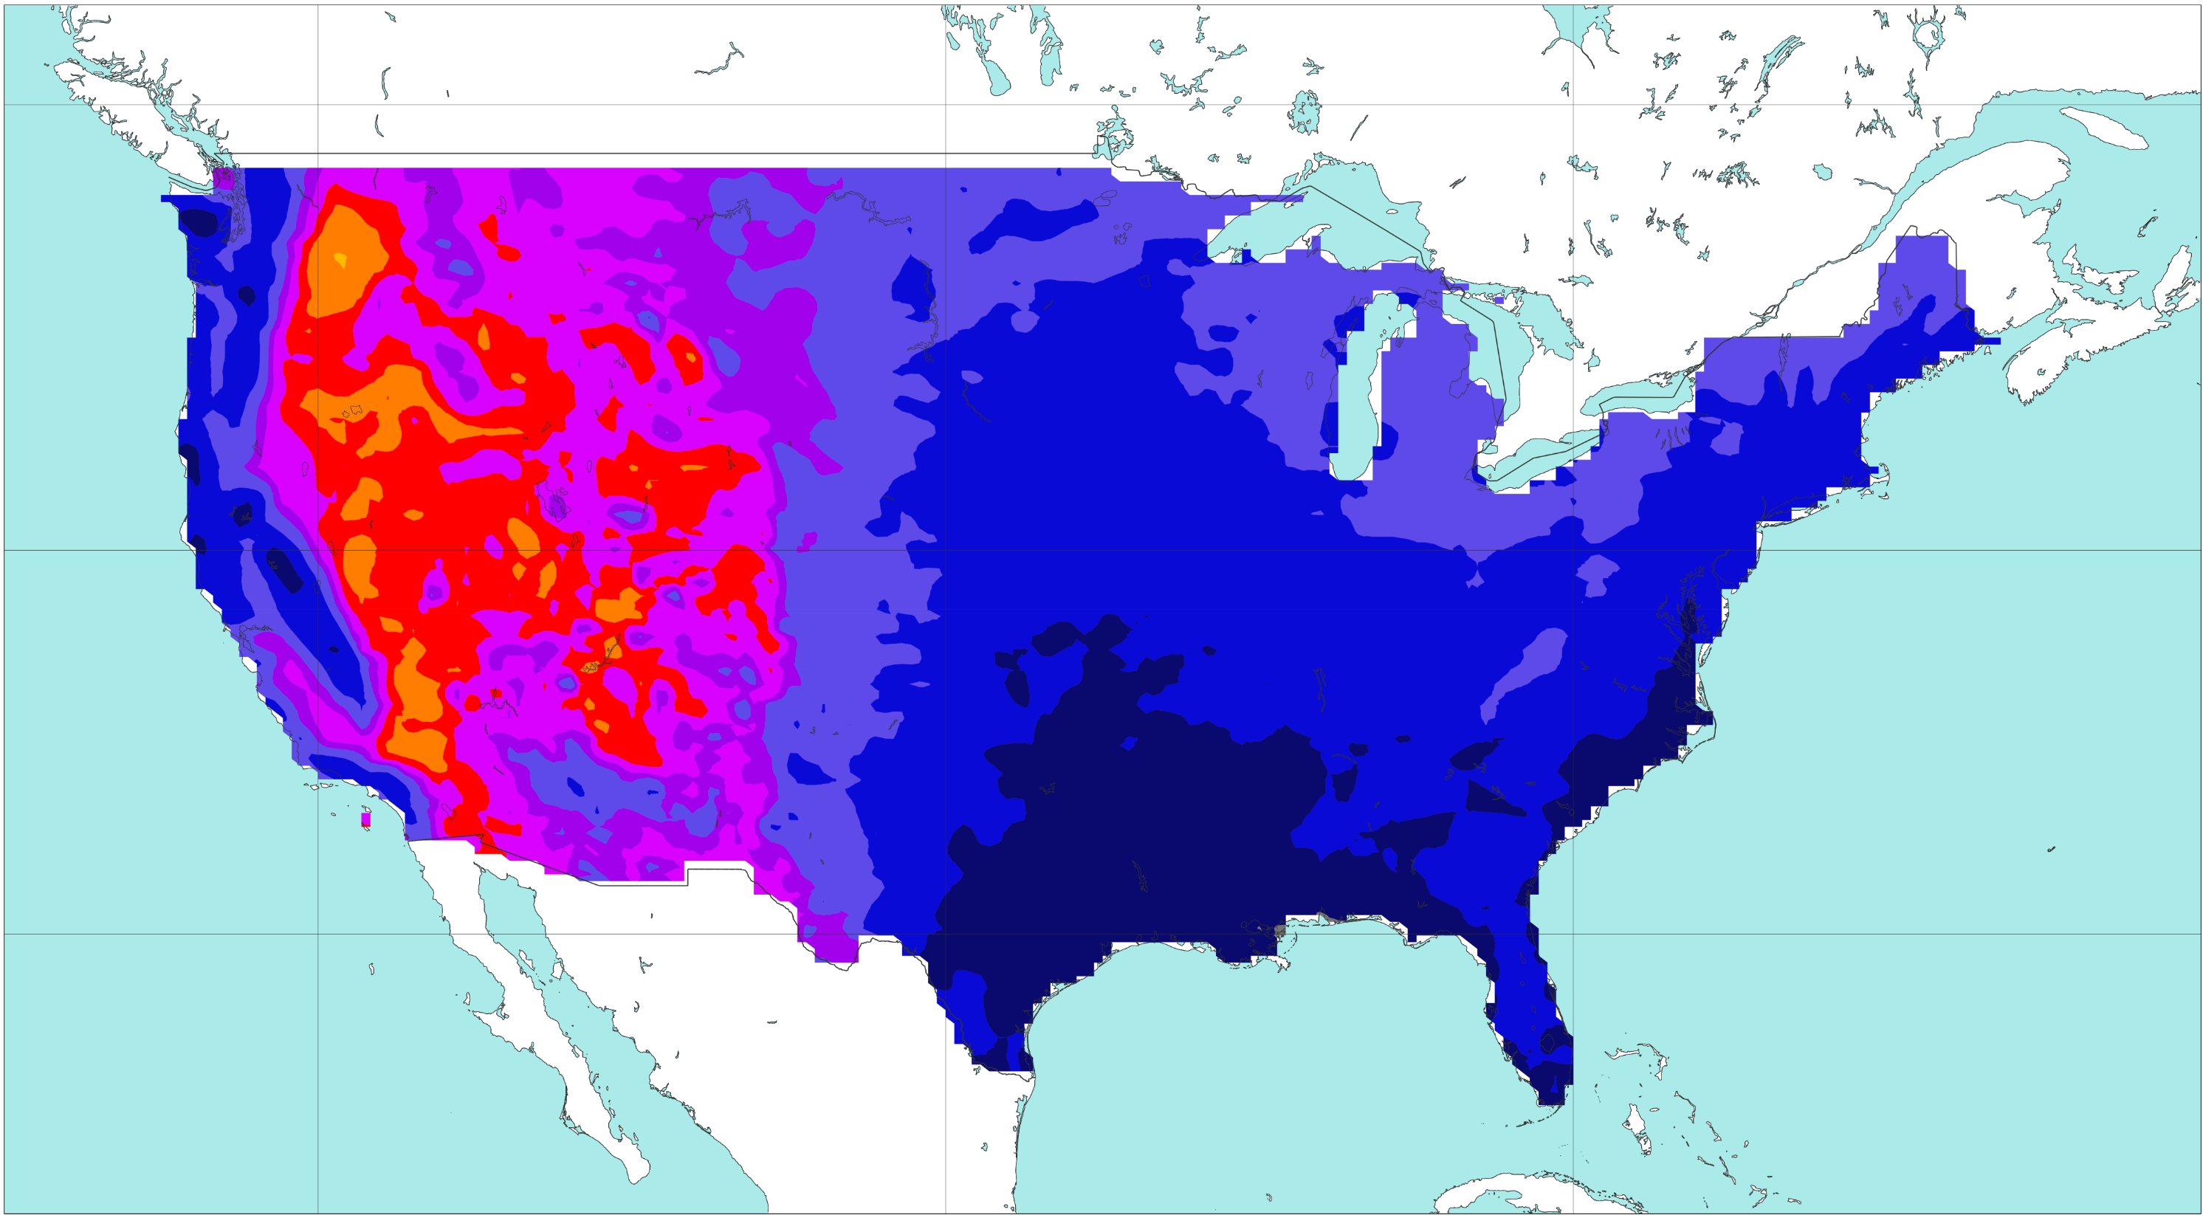
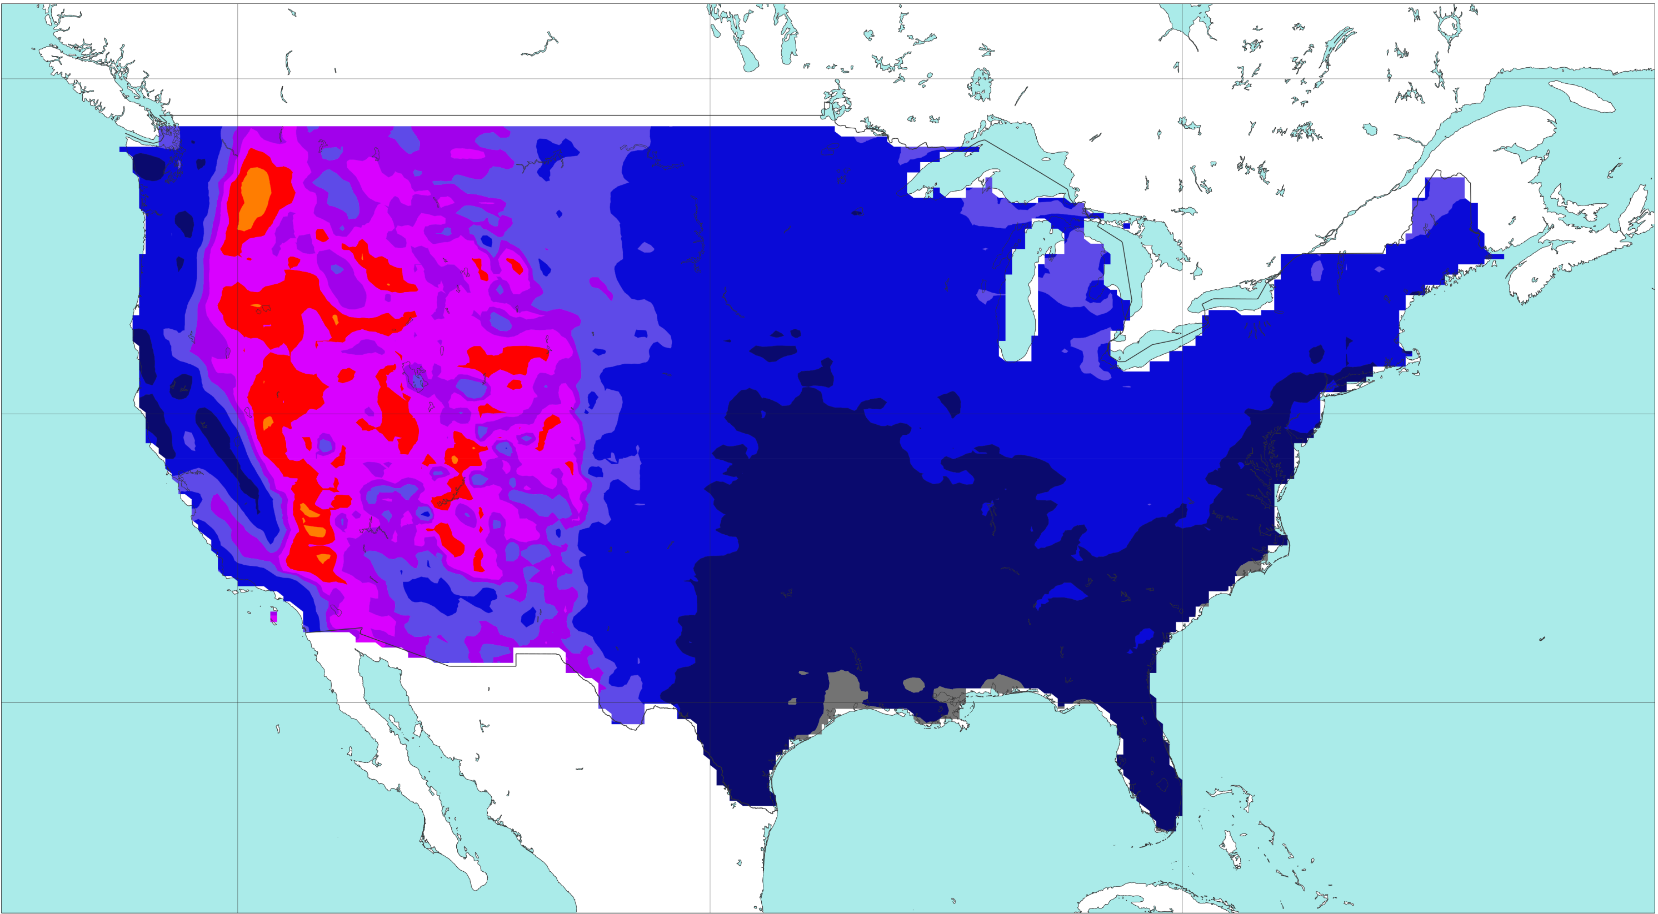
Rainfall climatology
Rainfall climatology from ERA5-ecPoint (static fields)
[mm/24h]
0
0.5
2
5
10
20
30
40
50
60
80
100
125
150
200
300
500
5000
a) 1-year return period
b) 5-year return period
50 °N
40 °N
30 °N
c) 10-year return period
d) 20-year return period
50 °N
40 °N
30 °N
e) 50-year return period
f) 100-year return period
50 °N
40 °N
30 °N
120 °W
100 °W
80 °W
120 °W
100 °W
80 °W

